Slide 1
SSB in Newegg
Wison.W.He
10/28/2014

Slide 2
Agenda
What is SSB
SSB in Newegg
Newegg SSB Workflow
Demo
QA

Slide 3
What is SSB
Service Broker is a new feature in SQL Server 2005,which can be used for asynchronous data processing based on dialog.
The big difference between service broker and other queuing technologies is that Service broker stores the messages in queue with the database, so service broker has the transaction character(ACID).

Slide 4






Initiator
Target
Dialog
Transmission
Initiator Queue
Target Queue

Slide 5
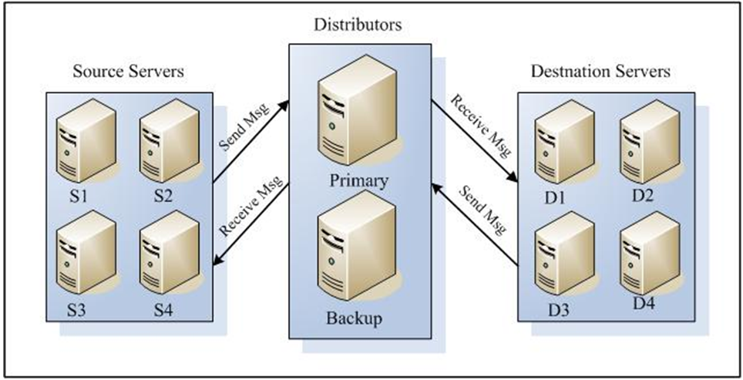
SSB in Newegg
macroscopic

Slide 6
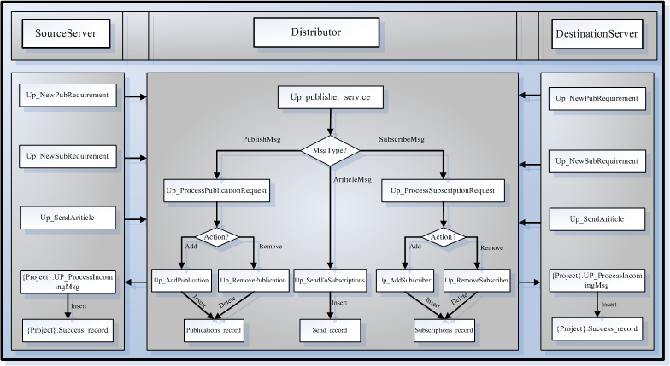
SSB in Newegg
microcosmic

Slide 7
Database
  SSB/SSB3
Table
  [PubSubService].[Send_Record]
  [PubSubService].[Exception_Record]
  {<ProjectName>}.[Success_Record]
Procedure
  {< ProjectName>}.[Up_ProcessIncomingMsg]
  [PubSubService]. [Up_SendArticle]

Slide 8
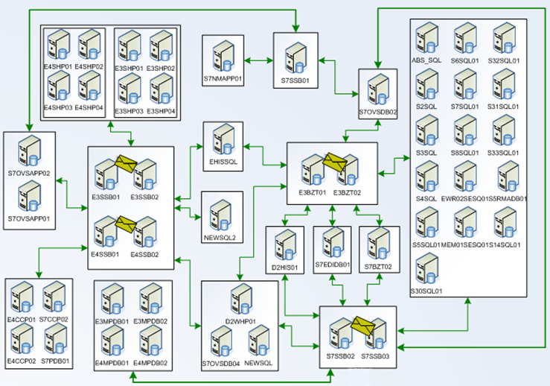

Slide 9
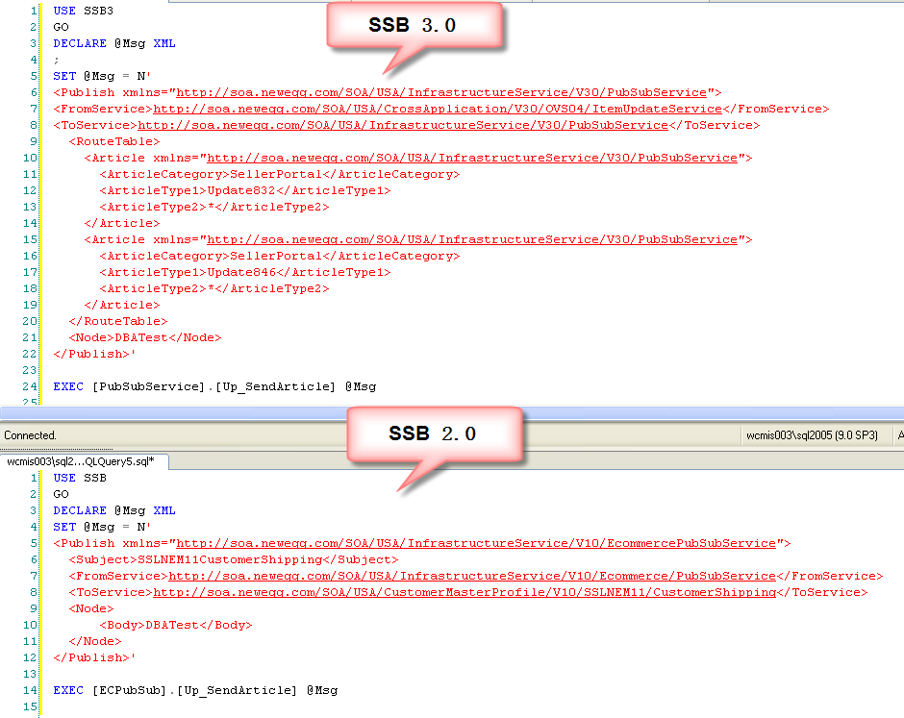

Slide 10
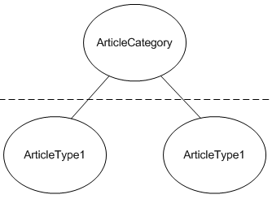

Distribute Algorithm
SSB 3.0
  Matching Elements
  Matching Condition
SSB 2.0
  Match Subject Element only

Slide 11
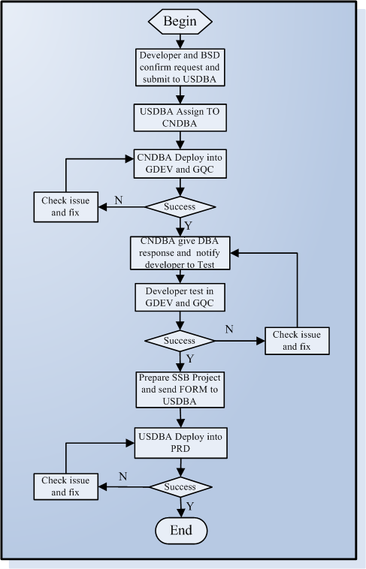
Newegg
SSB
WorkFlow

Slide 12
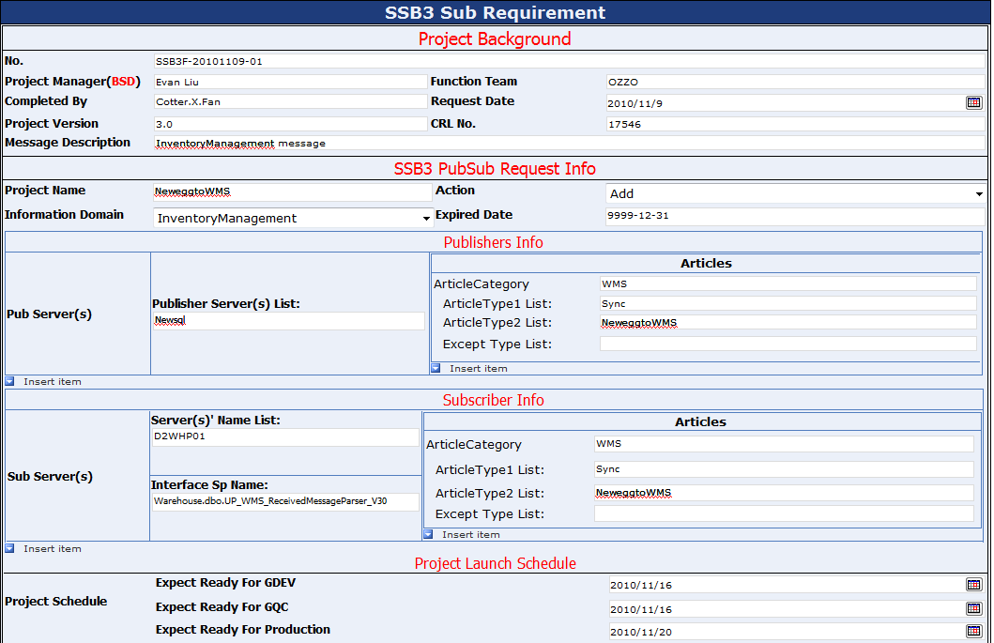

Slide 13
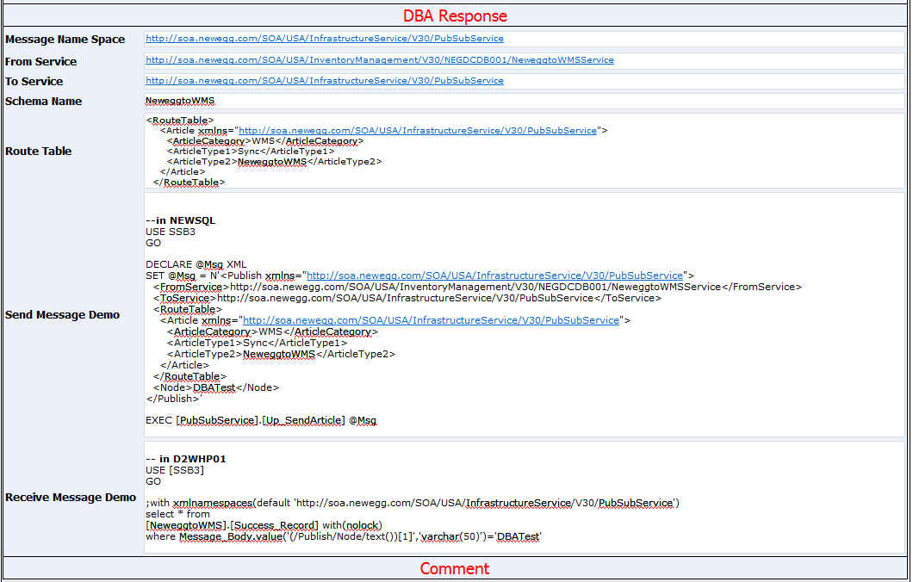

Slide 14
Demo

Slide 15
QA

